Slide 1

The Impact of COVID on Australian Tourism
Paul Roberts, Jens Weimann
& Dale Hancke

Slide 2
Objectives and Overview
What questions did we ask and why did we choose this topic:
Interest in the topic and the findings, specific to Australia
How were the states impacted during this period in relation to each other?
How were various tourism-related industries impacted?
How was the job market impacted here?
How is the tourism market recovering?
Where did we find the data to answer the questions?
Data taken from Tourism Australia and ABS data on Tourism

Slide 3
Big Picture: Impact on Airline travel
The Process:
Obtain the data from ABS and convert to a .csv to be generate a DataFrame
Go through reformatting to allow presentation on a graph
Use summary statistics to create a “Pre-COVID” and “Post-COVID” DataFrame to compare impacts:
Describe the data for each new dataset
Calculate the monthly growth of “Short-Term Visitors”
Get the r-value of each dataset to generate trendlines
Visualise the data in graph format

Slide 4
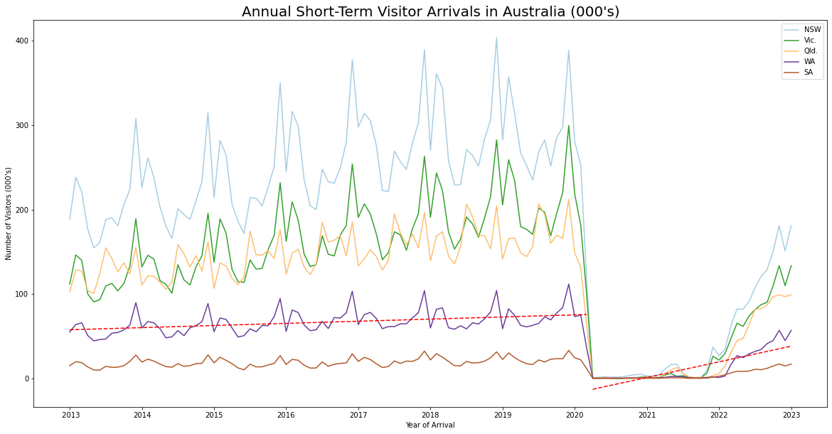
Big Picture: Impact on Airline travel
The Outcome:
Expected:
During COVID-19 flights and visitors would drop significantly
Peaks and troughs at the start and end of years (holiday season)
Surprises:
Each state had a consistent pattern and grew consistently
Recovery period is rapid and indicates strong growth into the future
Trendlines indicate the difference in “Pre-Covid” and “Post- Covid” growth
Expected that within 5-6 months recovery will reach “Pre-Covid” average as indicated by monthly growth
Caveats and Considerations:
The spread of data offers a safe consideration to the legibility of data
“Post-Covid” data is still new and should be monitored carefully
Considering the characteristics for each state is necessary to generate an accurate representation

Slide 5
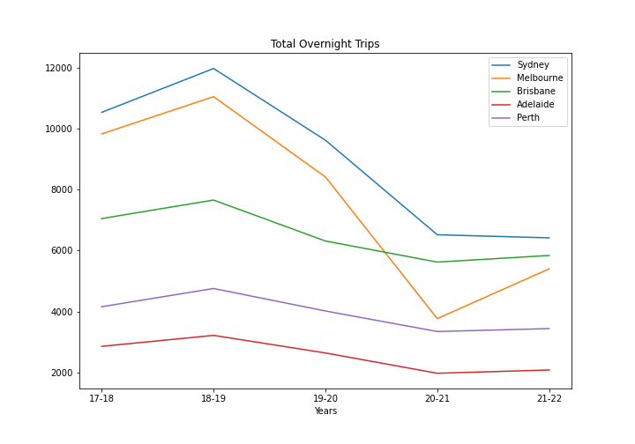
REGIONAL IMPACT: COVID IMPACT BY STATE
The Outcome:
Expected:
Declines across the board
Sydney and Melbourne showed the largest decreases
Surprises:
No surprises with this data
Caveats and Considerations:
Didn’t look into the smaller markets of Hobart and Darwin
Didn’t look into regional areas

Slide 6
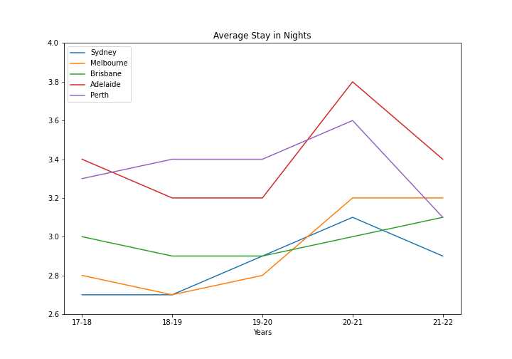
REGIONAL IMPACT: OVERNIGHT STAYS
The Outcome:
Expected:
Declines across the board
Surprises:
The average stay in nights increased for all states
Caveats and Considerations:
Only looked at a short period

Slide 7
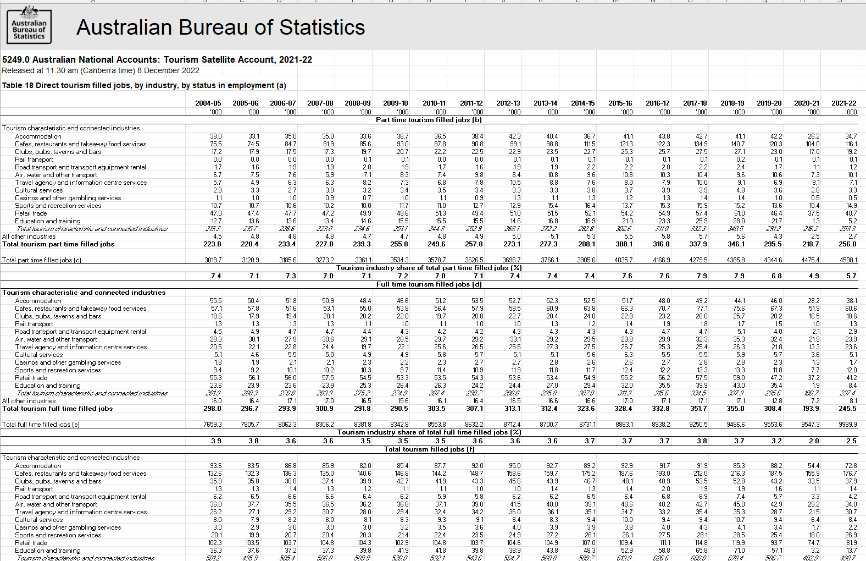
PEOPLE Impact: Tourism-related Jobs
The Process:
Multiple columns and formats
Cleaned in Excel
Create a CSV on the combined totals
Imported the various libraries in Python to code
Had to remove commas, standardize on integers and strings where applicable, as well as reformat headings in the DataFrame
Created a line plot but thought a bar-graph would be more impactful

Slide 8
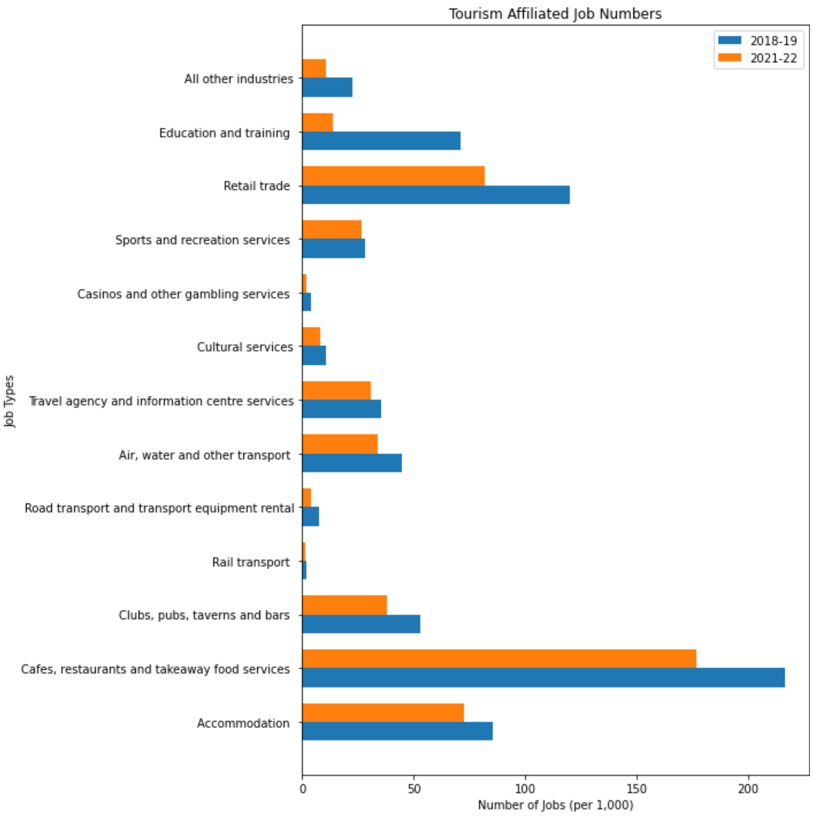
PEOPLE Impact: Tourism-related Jobs
The Outcome:
Expected:
Declines across the board
Restaurants and retail were most impacted (as per the media coverage)
Surprises:
Accommodation numbers not as impacted as I expected (aligned to Paul’s data)
Travel Agencies and Info Centers figures not so bad?
The big delta in education and training – need further exploration
Gambling and sports and recreation are pandemic-proof?
Caveats and Considerations:
Timeframes chosen are specific – may need to define when COVID peaked and when we would consider “recovery” started
Single dataset

Slide 9
PEOPLE Impact: Tourism-related Jobs BY GENDER
The Process:
Obtain the data from ABS and convert to a .csv to be generate as a DataFrame
Go through reformatting to allow presentation on a graph
Create a new DataFrame representing the proportion of jobs annually
Generate summary statistics and r-values of the data to identify trends for each dataset
Total Jobs
Female Main Jobs
Male Main Jobs
Plot the data on a DataFrame and generate trendlines to identify growth

Slide 10
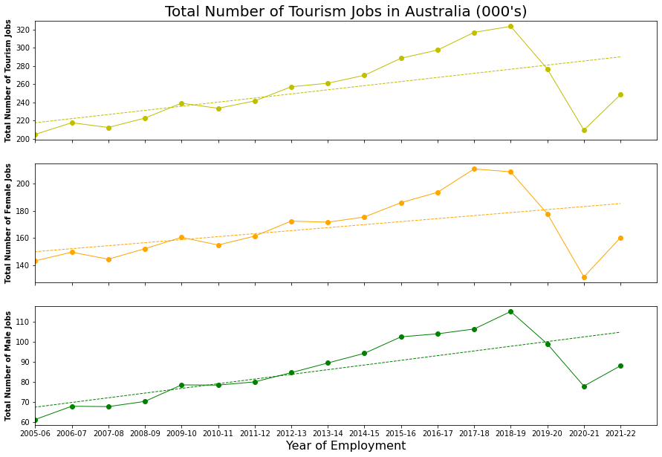
PEOPLE Impact: Tourism-related Jobs BY GENDER
The Outcome:
Expected:
Decline during “peak COVID-19”
The total number of jobs would maintain consistent with visitors entering Australia
Strong positive growth for tourism jobs in Australia
Surprises:
A larger proportion of jobs are occupied by females. A consistent trend annually
COVID-19 caused the job market to become equivalent to that of 2005 to 2006
Significant growth from 2007 to 2010
Loss of 144,000 jobs during COVID-19
Caveats and Considerations:
The data provided by ABS is for all Australia and may not represent each state accurately
The recovery of jobs after COVID-19 is strong and monthly growth considerations may provide greater growth details

Slide 11
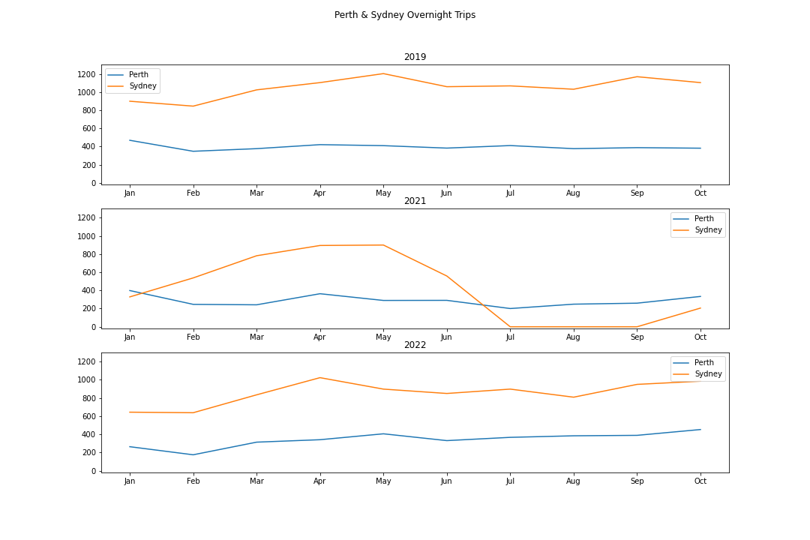
Are we back to normal?

Slide 12
THANK YOU

